Slide 1
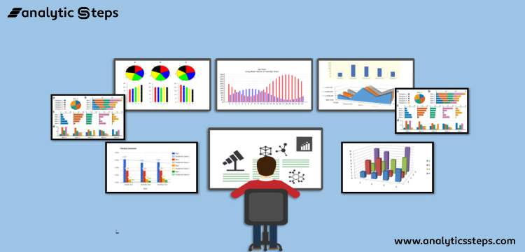
Regression –Prediction of Store Sales
MiNI PROJECT 2

Slide 2
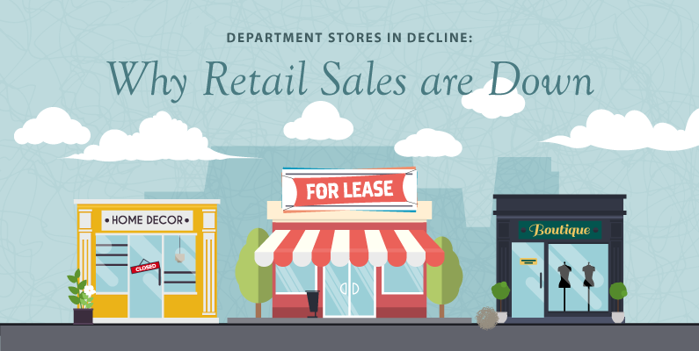
Business Objective ●Build a model to predict the Sales of a store

Slide 3
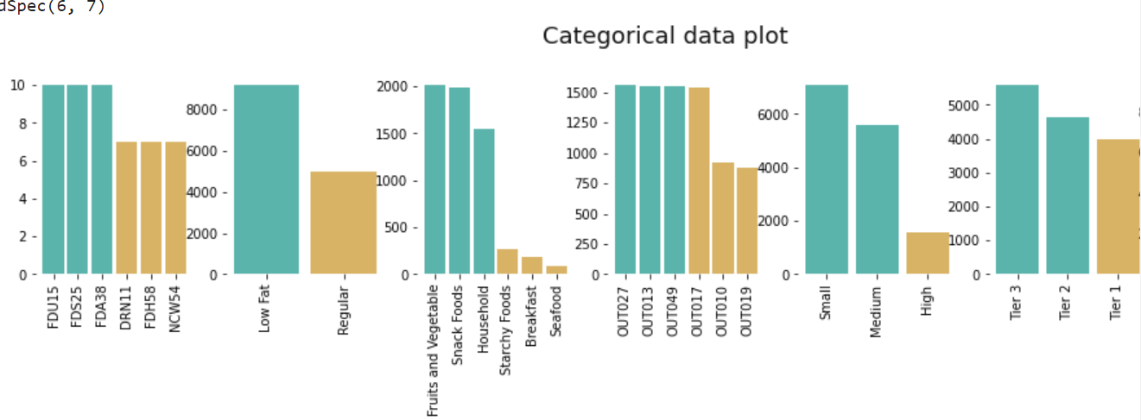
EXPLORATORY DATA ANALYSIS
Categorical Data Plot
Store have Highest Amount Low Fat contain Product
People Having Highest Amount of Small Outlets
Most of The Store Located at Tier3 Area

Slide 4
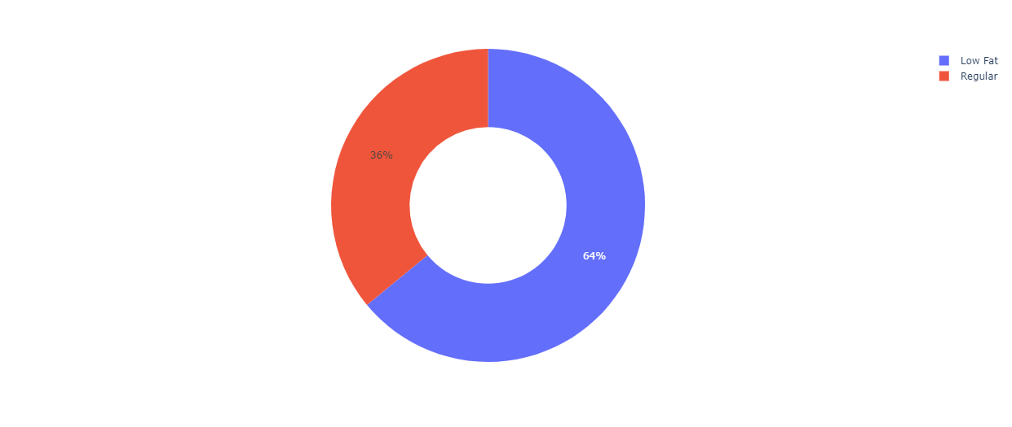
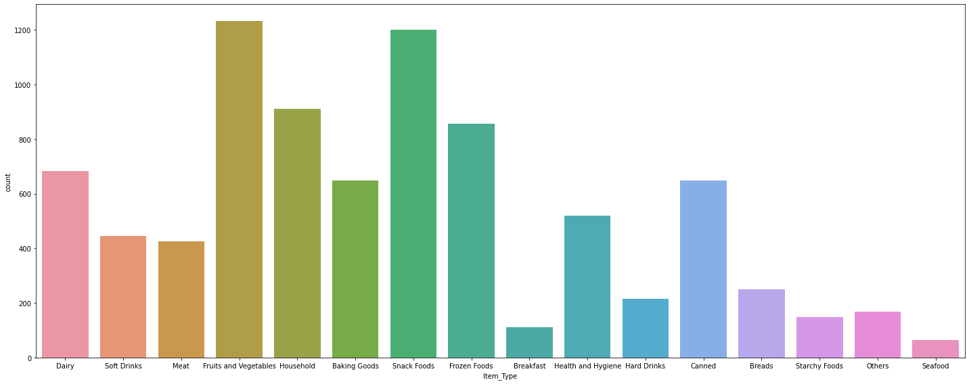
STORES CONTAIN HIGHEST AMOUNT OF LOW FAT PRODUCT
MOST OF THE STORES SELL FRUITS AND VEGETABLES

Slide 5

TECHNICAL DETAILING

Slide 6
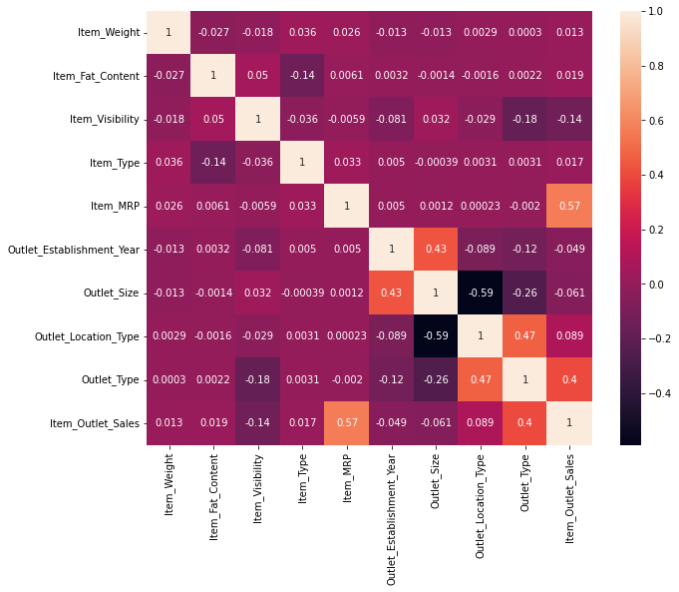
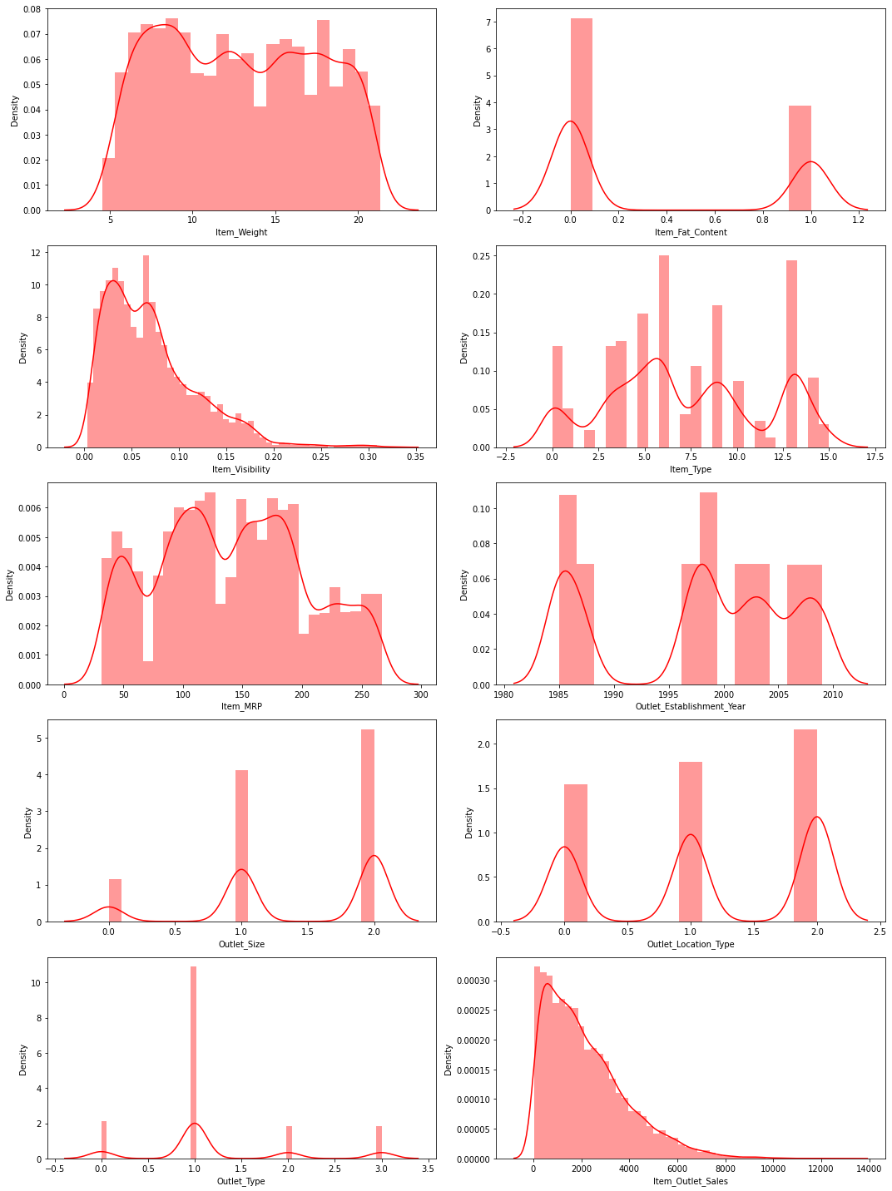
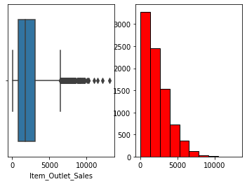
DATA SET CONTAIN OUTLIERS
-Most of The features Contain OUTLIERS
- Most of the feature are positively Skewed
- Item_MRP and ITEM_OUTLET_STORES are correlated

Slide 7
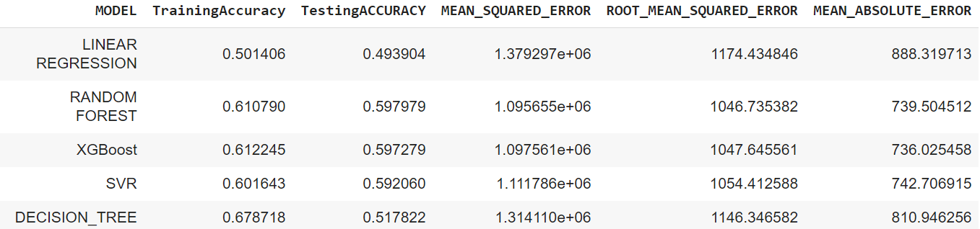
FINDING BEST ALGORITHM
DATA FRAME for best Algorithm
Taking Random FOREST as the Best Algorithm because Testing and Training Accuracy are closer to each other
And Error are also less comparision to other Model

Slide 8
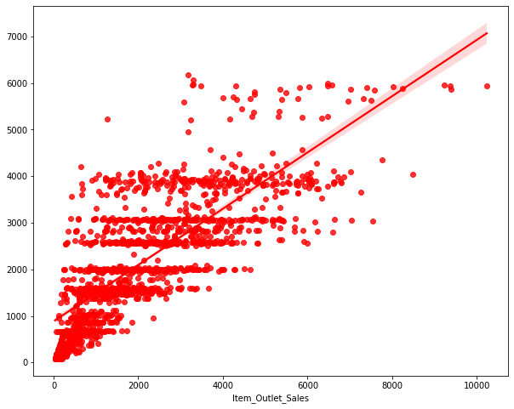
RANDOM FOREST
Random FOREST is BOOTSRAP AGGREGATION (BAGGING ) ALGORITHM which uses number of DECISION TREE
Planted parallely and Reduce Overfitting in the model
It convert low Bais and High Variance into Low Bais and Low Variance

Slide 9
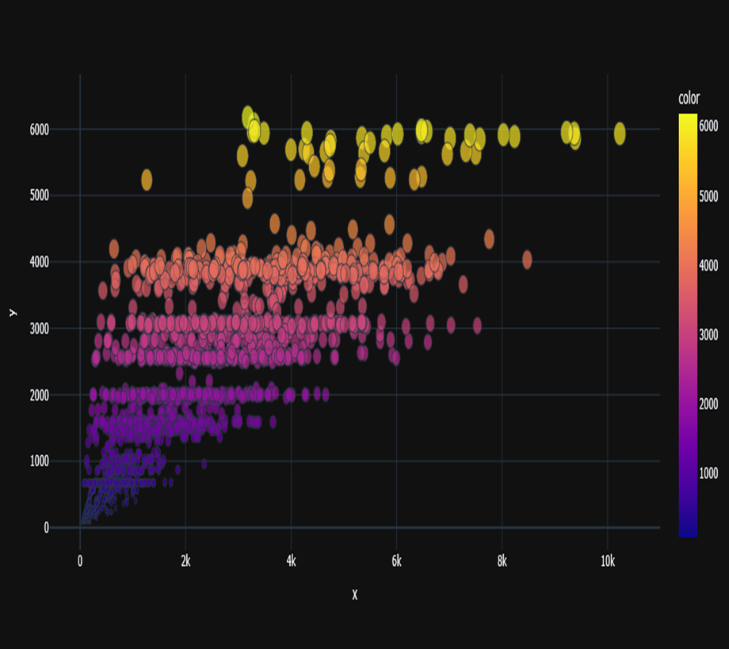
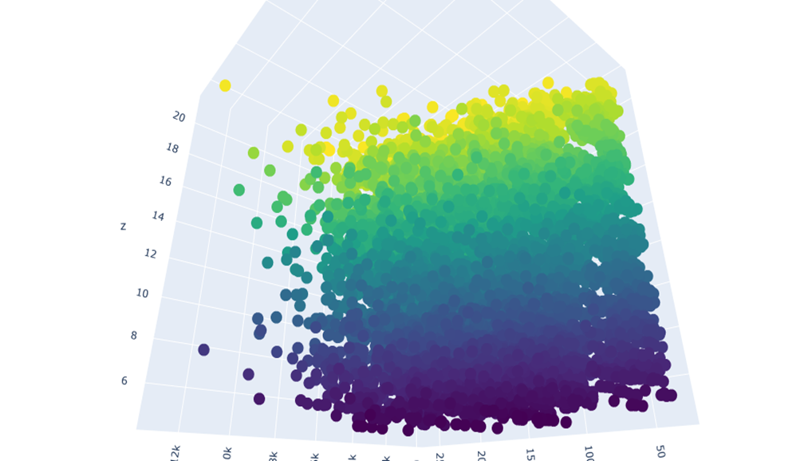
Scatter in 2D Scatter in 3D

Slide 10
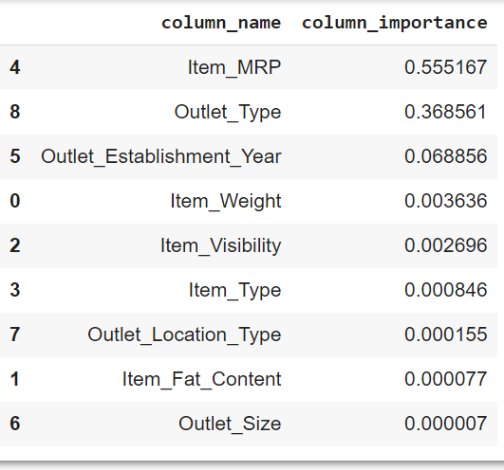
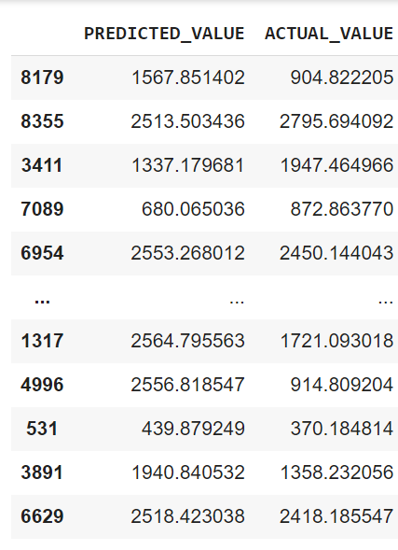
BEST FEATURES FOR RANDOM FOREST
BEST FEATURES PREDICTED AND ACTUAL

Slide 11
NEW LIBRARY EXPLORE
KLIB LIBRARY
SWEETVIZ LIBRARY – EDA LIBRARY
PLOTLY- INTRACTIVE
XGBOOST REGRESSOR – XTREME GRADIENT BOOSTING
CONCLUSIONS
How a small-sized outlet located At TIER3 area recorded the highest sales by selling Vegetables and Fruits, suggesting that other shopping locations may benefit like small one at TIER3 by selling More Vegetables and Fruits. Should follow similar patterns for improved sales.
- Item_MRP and ITEM_OUTLET_STORES are correlated this variables was expected to have high impact in the sales increase

Slide 12

THANK YOU

